Slide 1
Restaurant 2018 Interface Rukshar Parwin – A & B Taylor daniels – C & D BRENDA Nyangweso – e & f

Slide 2
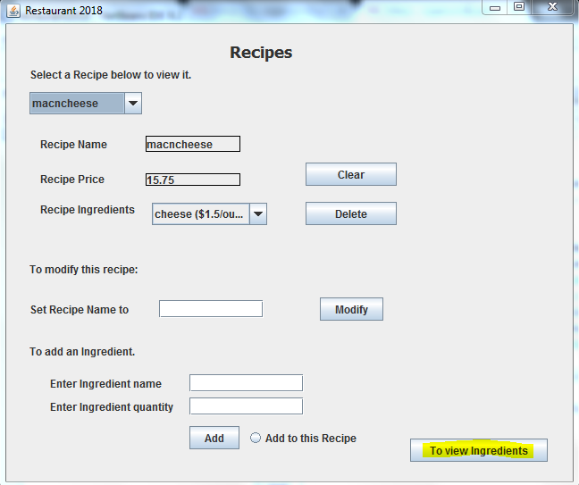
A: Add new ingredient
This is the main panel of the recipe.
To Add a new ingredient, click on the tab highlighted in the screenshot

Slide 3
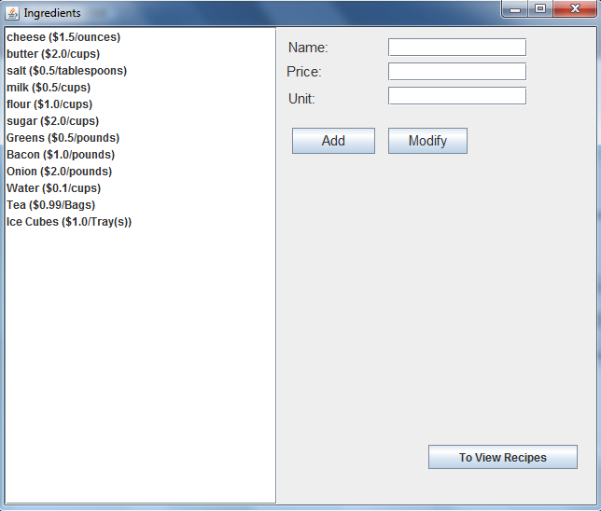
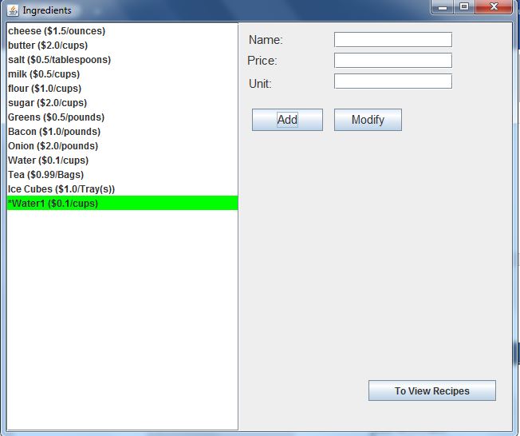
A: Add new ingredient

Slide 4
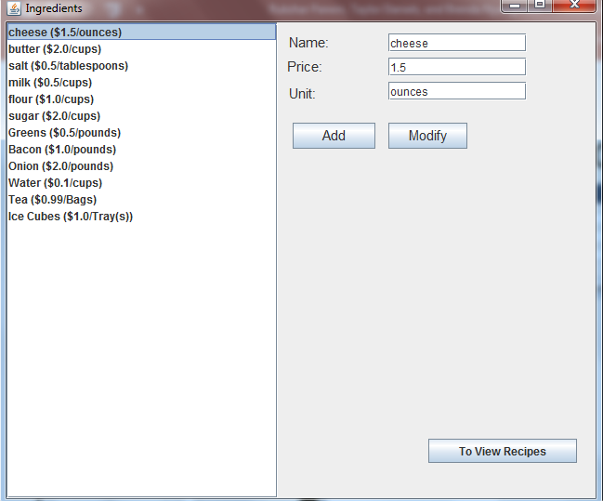
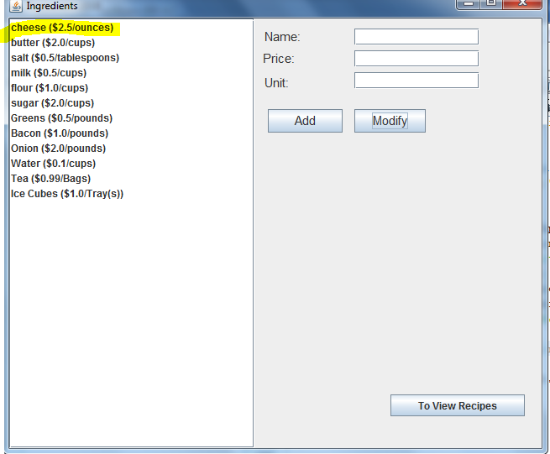
B: Modify ingredient data

Slide 5
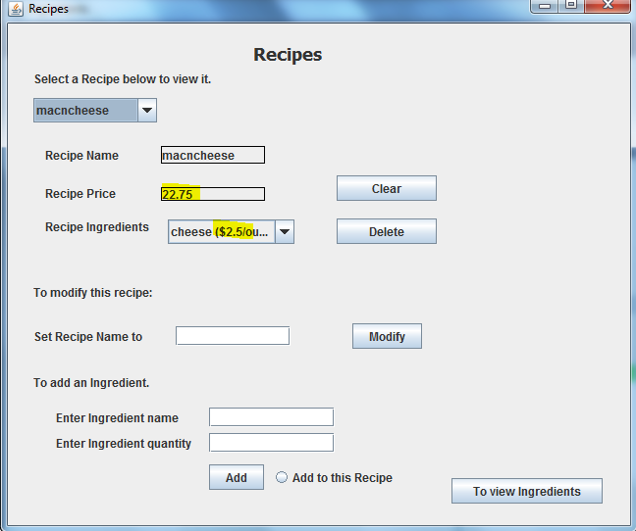
G: Update recipe price

Slide 6
H: Show ingredients that are not being used

Slide 7
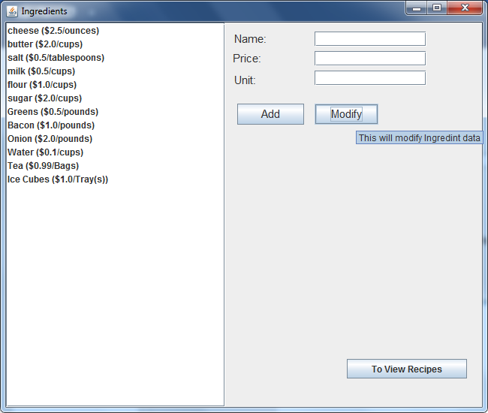
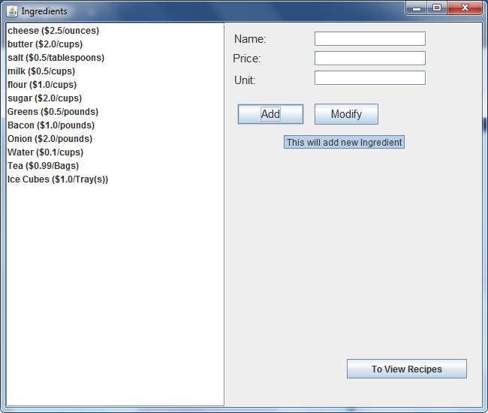
Tool Tip

Slide 8
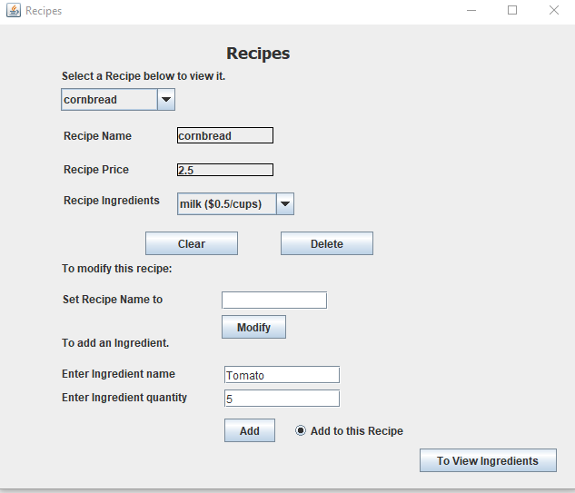
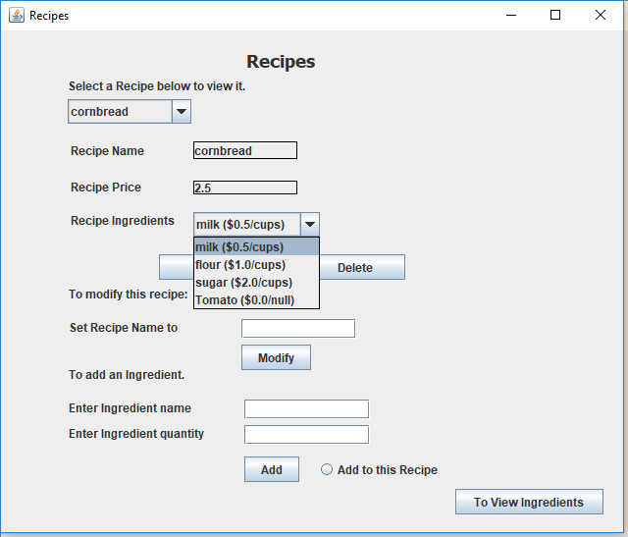
E: Modifying Recipes

Slide 9
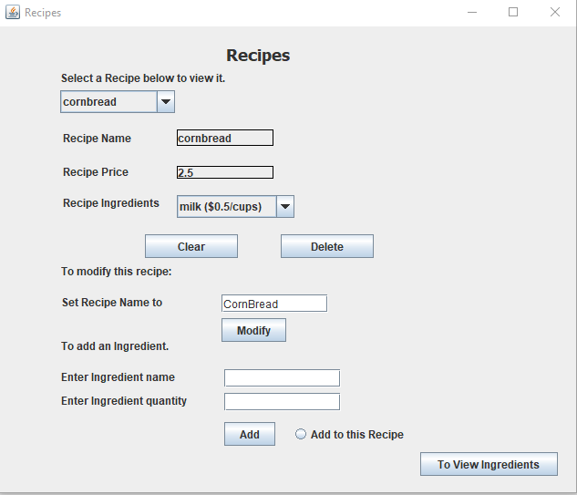
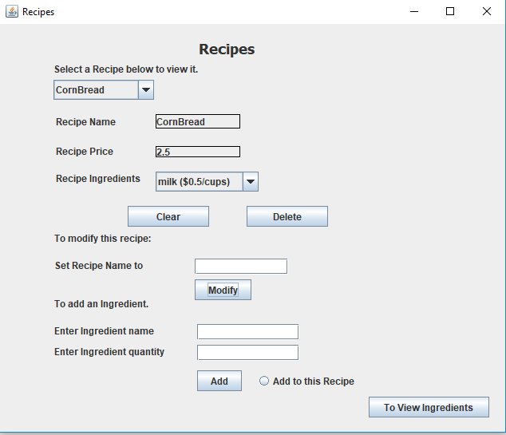
E: Modifying Recipes

Slide 10
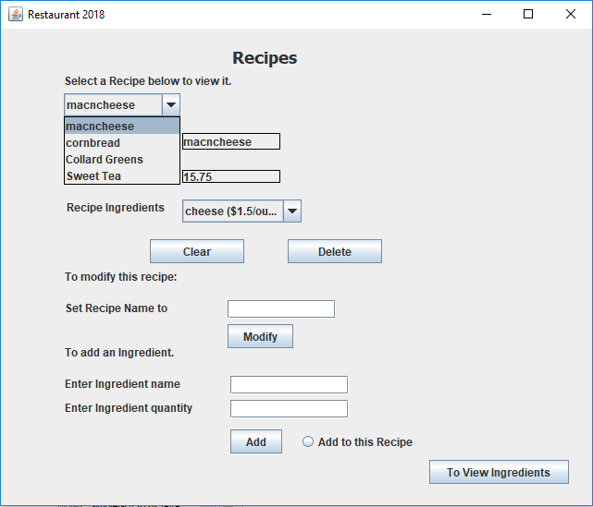
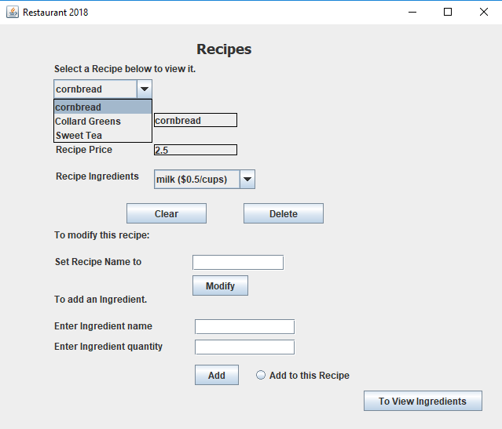
F: Deleting Recipes

Slide 11
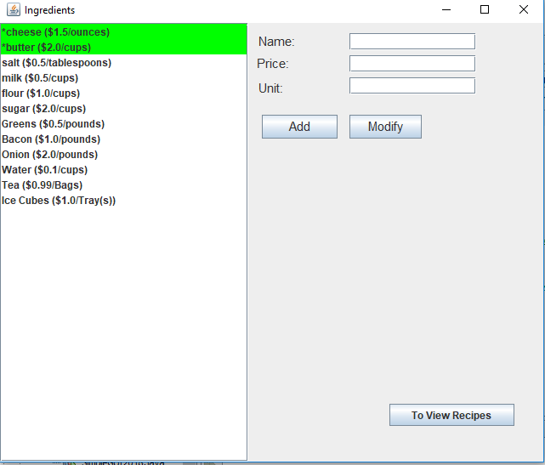
G: Updating Ingredients after Deleting a Recipe

Slide 12
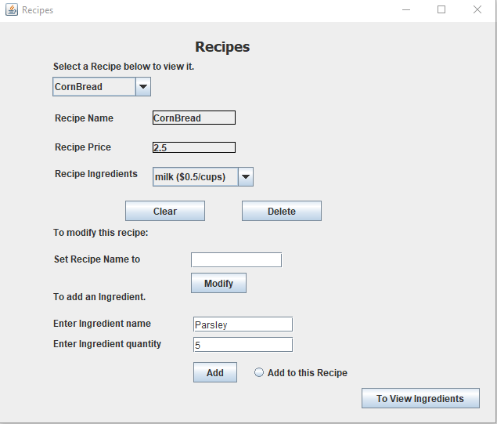
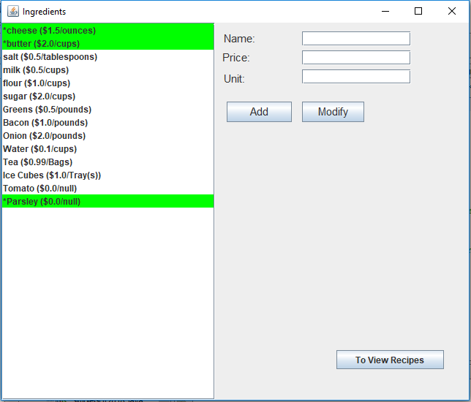
H: Ingredients that are not being used by any Recipe

Slide 13
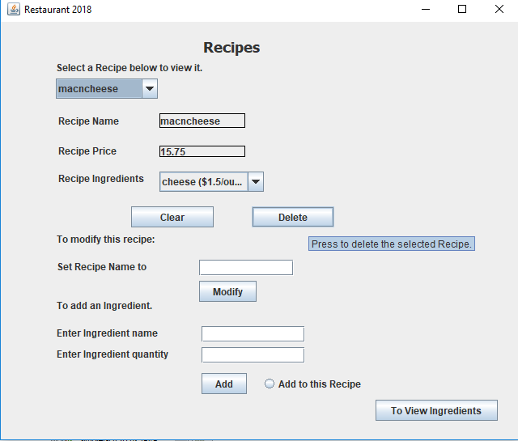
Tool-Tips on the Recipes panel

